Slide 1
Operating System Security
CYS337

Slide 2
Members of Group 1
STUDENT NAME | STUDENT NUMBER
01. James Soko | 20231392
02. Evans Bwalya | 20231947
03. George Mwape | 22175203
04. Victor Chola | 20231349
05. Ndhlovu Cuthbelt | 20231784
06. Ernest Washeni | 20230180
07. Bethsaida Chileshe | 20230495
08. Demetries Mwape | 20231512
09.Obed Mwape | 20231799
10. Rosaria Phiri | 20230145

Slide 3
Members of Group 1 (Continues…)
STUDENT NAME | STUDENT NUMBER
11. Violet Kikumbaila | 20231791
12. Florence Mate | 20231587
13. Boyd Phiri Jr. | 20231939
14. Esther Ngoma | 20230442
15. Samuel Chishimba | 20232073
16. Angela Bwalya | 20231710
17. Chembo Major | 22175219
18. Mukwasa Joshua | 20231950
19. Howard Musakanya | 20231490
20. Mary Chanda | 20231336

Slide 4
Members of Group 1 (Continues…)
STUDENT NAME | STUDENT NUMBER
21. Lawrence Tembo | 20232016
22.Gabriel Kapambwe | 20230192
23. Henry Mutale | 20231604
24. Chimuka Muntanga | 20231270
25. Jamin Sibeleki | 20230492
26. Alice M. Chota | 22175367
27. Nathan Chintu | 22175221
28. Tracy Tembo | 20231854
29. Courage Silweya | 20230099
30. Mwape Champo | 20230030

Slide 5
Members of Group 1 (Continues…)
STUDENT NAME | STUDENT NUMBER
31. Albertina Mwewa | 20231875
32. Dyton Ng'ambi | 20230163
33. Mwape Musonda | 20231716
34. Alinuswe Simbeye | 20231271
35. Ebby Mwale | 20231492
36. Cindy Ngandalo | 22175202
37. Ben Zulu | 20231886
38. Chimba Chanda | 20232011
39. Denson Chishala | 20231413
40. Jackson Maaka | 20230450

Slide 6
Question
Hacking Windows Admin login Account Using CMD or any tool of your choice (Hiren’s BootCD PE).
Question by Mr. Mwashi Matela
Due on the 16th of April, 2025.

Slide 7
Forgotten Your Password?
Bypassing Forgotten Password Using CMD

Slide 8
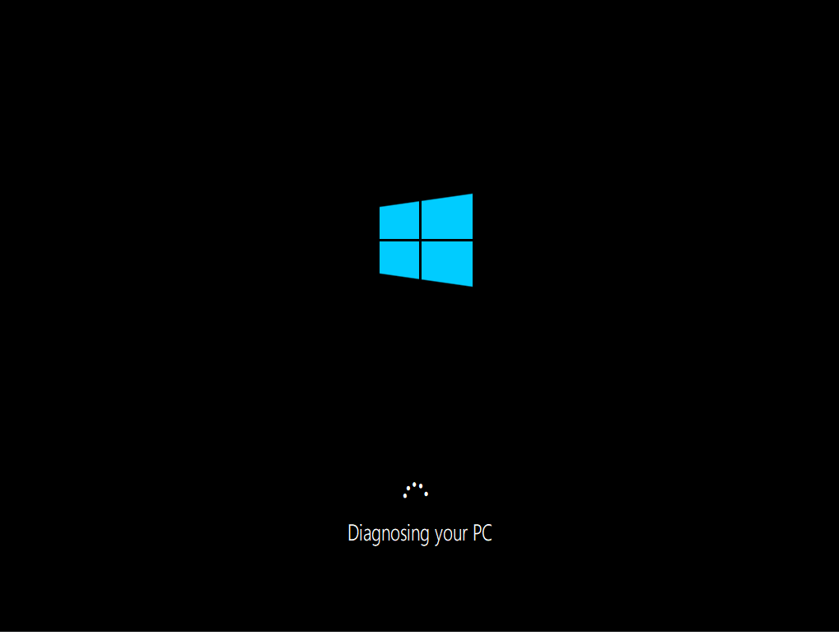
Repair Mode
Go into Windows repair mode, by forcing shutdown three (3) times.

Slide 9
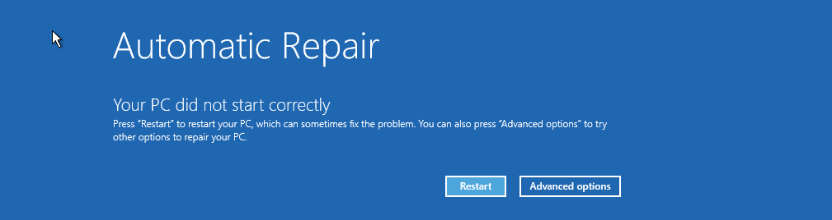

Advanced Options
Click on Advanced Options → Trouble Shoot

Slide 10

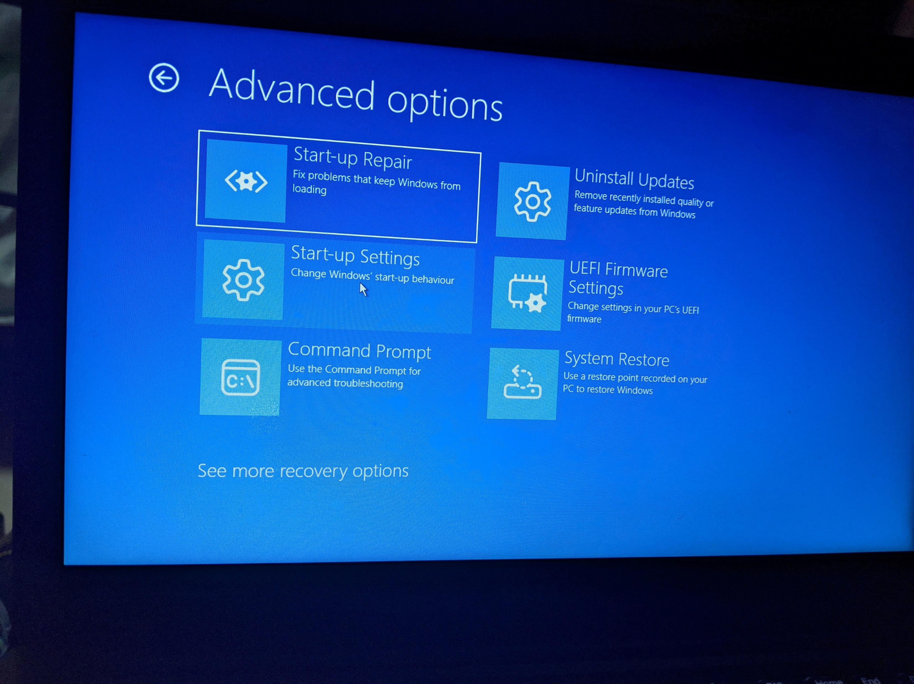
Recovery Options
Advanced Options → See More Recovery Options

Slide 11
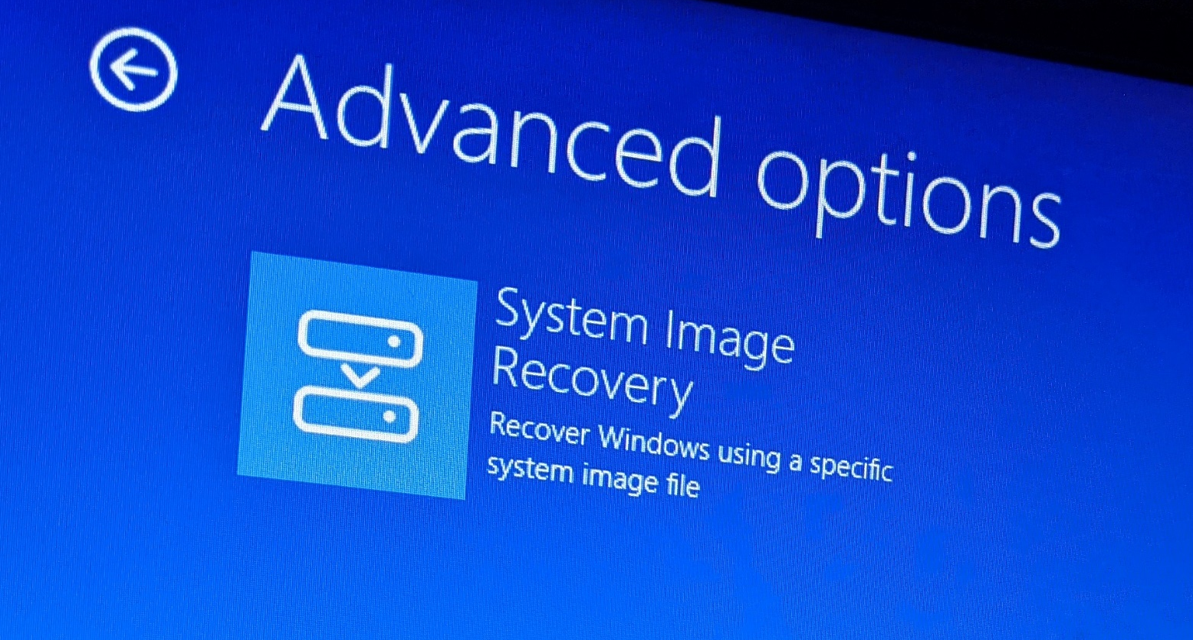
Image Recovery
System Image Recovery

Slide 12
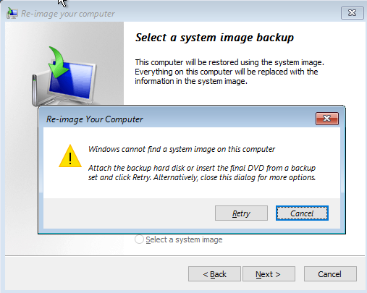
Image Recovery (Continues…)
What ever will pop up on the screen, click on Cancel

Slide 13
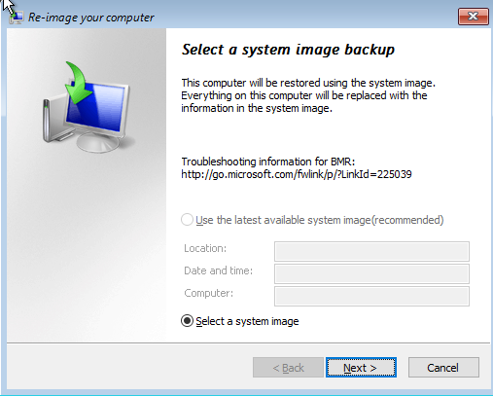
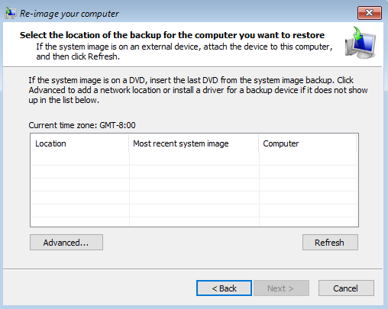
Image Recovery (Continues…)
Select a system image backup → Next > → Advanced…

Slide 14
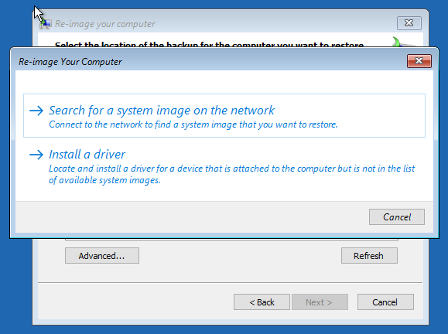
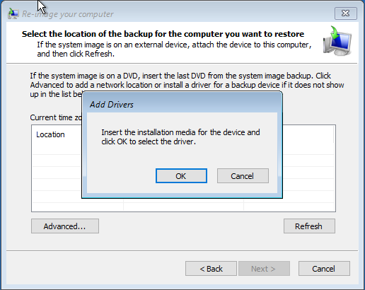
Image Recovery (Continues…)
A new window will pop, click Install a Driver → OK

Slide 15
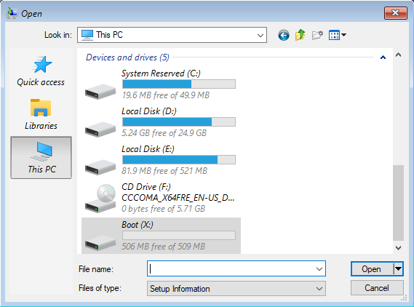
Local Disk (C) / (D)
Go on This PC → Local Disk (C) / (D)

Slide 16
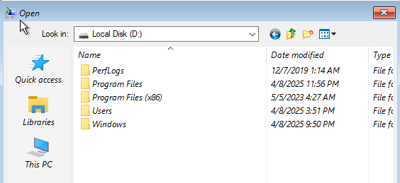
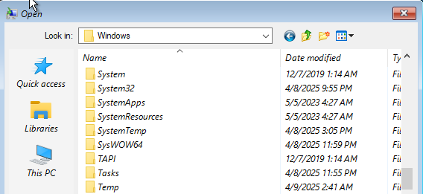
System32
Navigate the Folders;
Windows → System32

Slide 17
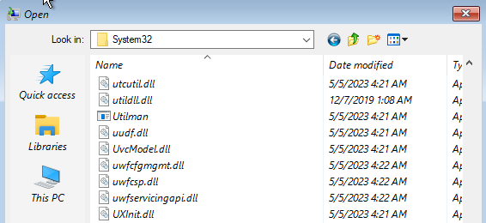
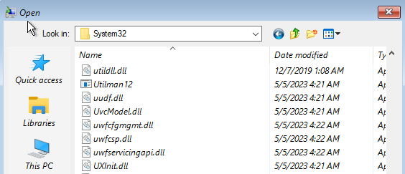
Utility Manager (Utilman)
Find the file called Utilman and Rename it (e.g., Utilman12) and Refresh the screen.

Slide 18
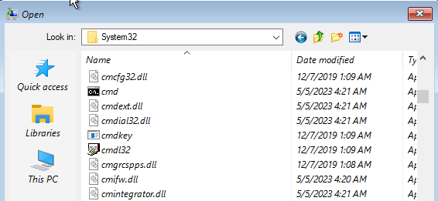
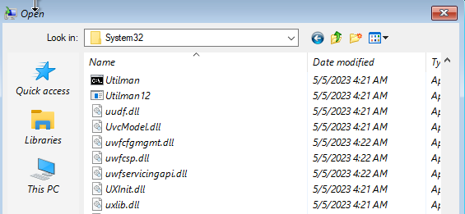
Command Prompt (CMD)
Locate cmd and Rename it to Utilman and Refresh the screen.

Slide 19

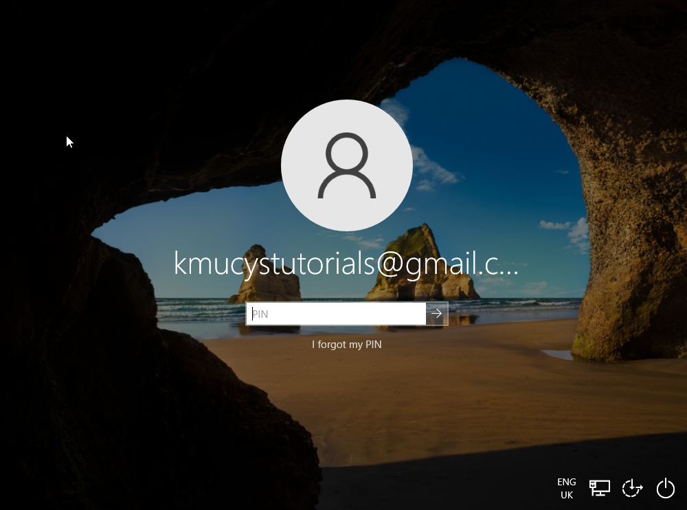

Accessibility
Close all the windows or tabs then click on Continue, wait for your Computer to restart and click on the Magic Icon (Accessibility) which is next to the Internet Icon.

Slide 20
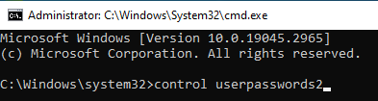
User Accounts
Command Prompt will appear, type in the command;
control userpasswords2

Slide 21
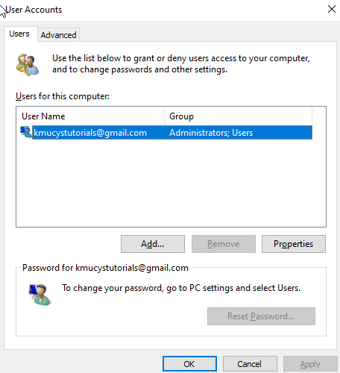
User Accounts (Continues…)
Then under User Accounts, click Reset Password…
Enter New Password or leave it blank and click on OK

Slide 22
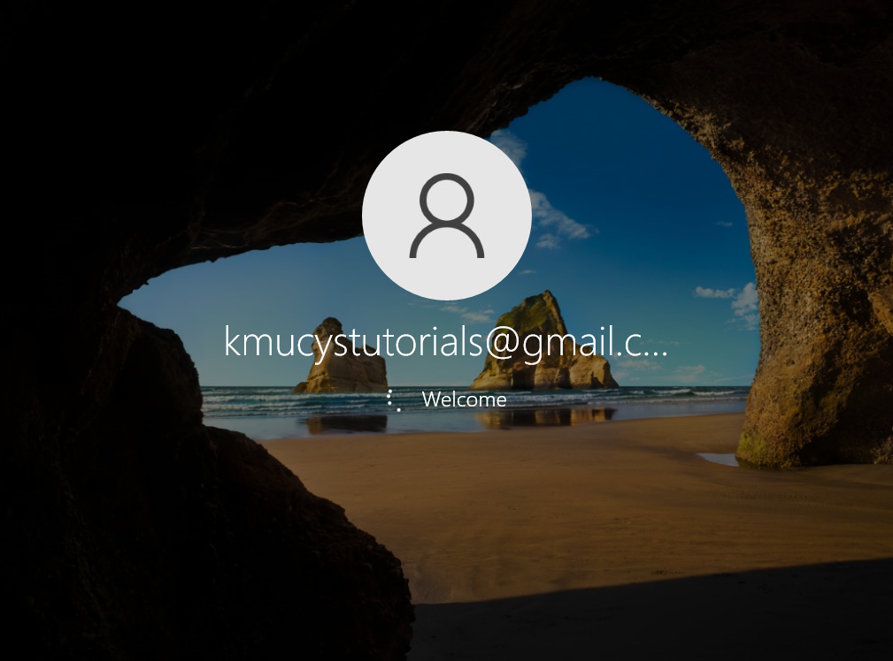
Login Page
Close the Command Prompt then Sign In with or without a password

Slide 23
Forgotten Your Password?
Bypassing Forgotten Password Using Hirens BootCD PE

Slide 24
Creating a Bootable Device
If you’ve downloaded Hiren’s BootCD PE from the actual web, the file will be written as .iso
Use a booting tool such as Rufus or PowerISO to make the .iso file bootable into your USB drive.
OR
If you have the Hiren’s BootCD PE as a folder, copy the files into an USB drive and you are ready to go.

Slide 25
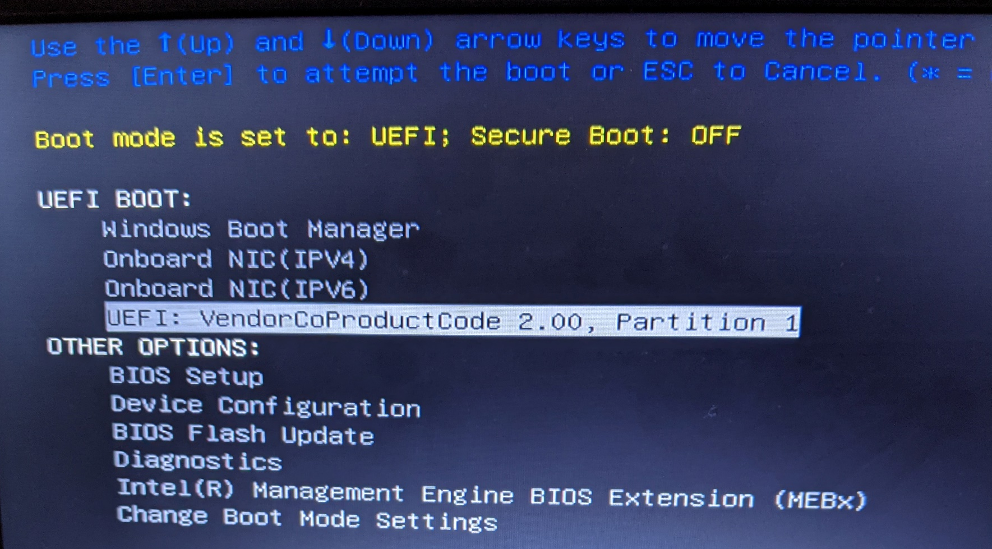
Boot Menu
Shutdown and restart your PC into the Boot menu by pressing F12 repeatedly depending on your manufacturer.
Select the bootable USB drive e.g., UEFI: VendorCoProductCode 2.00, Partition 1

Slide 26
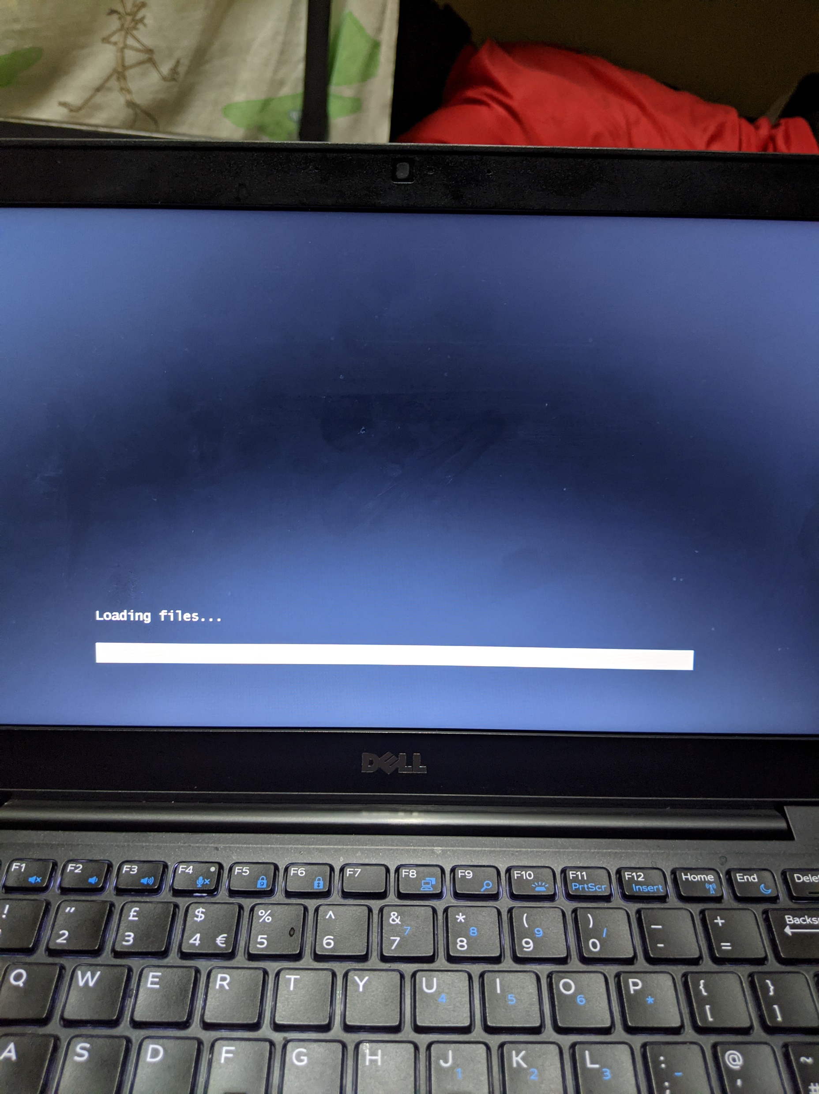
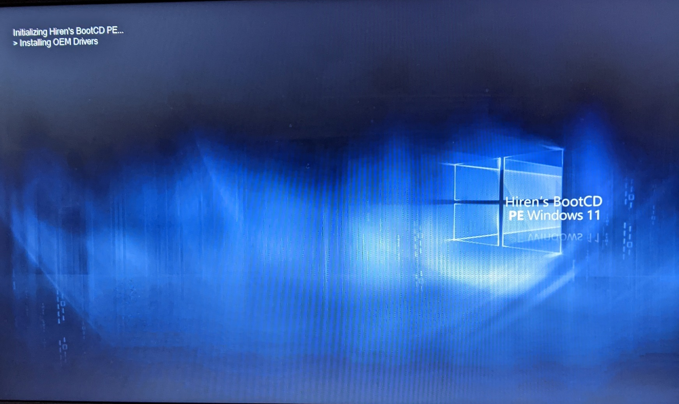
Hiren’s BootCD PE
Wait for Hiren’s BootCD PE to initialize and load up.

Slide 27
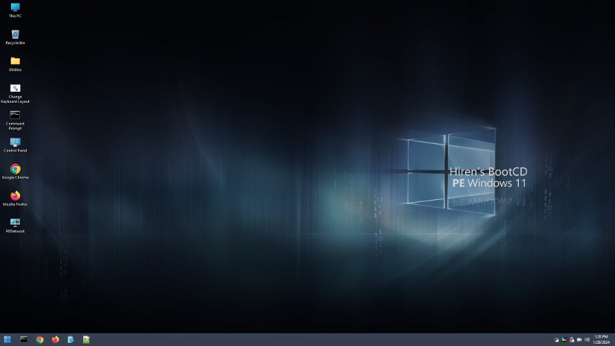
Utilities
Navigate to the folder called Utilities (Located on the Desktop)

Slide 28
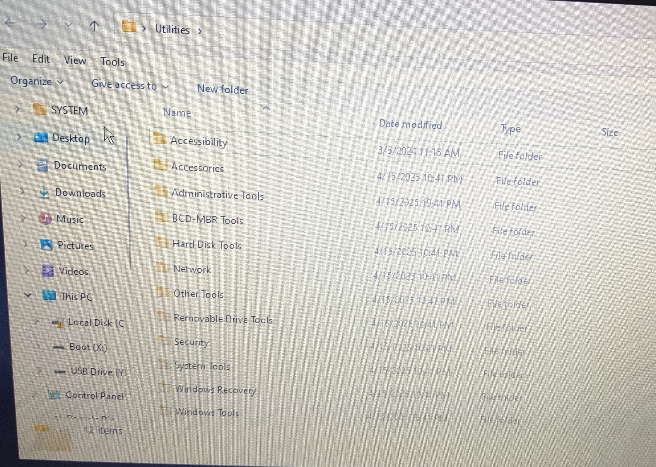
Security
Navigate to the folder called Security

Slide 29
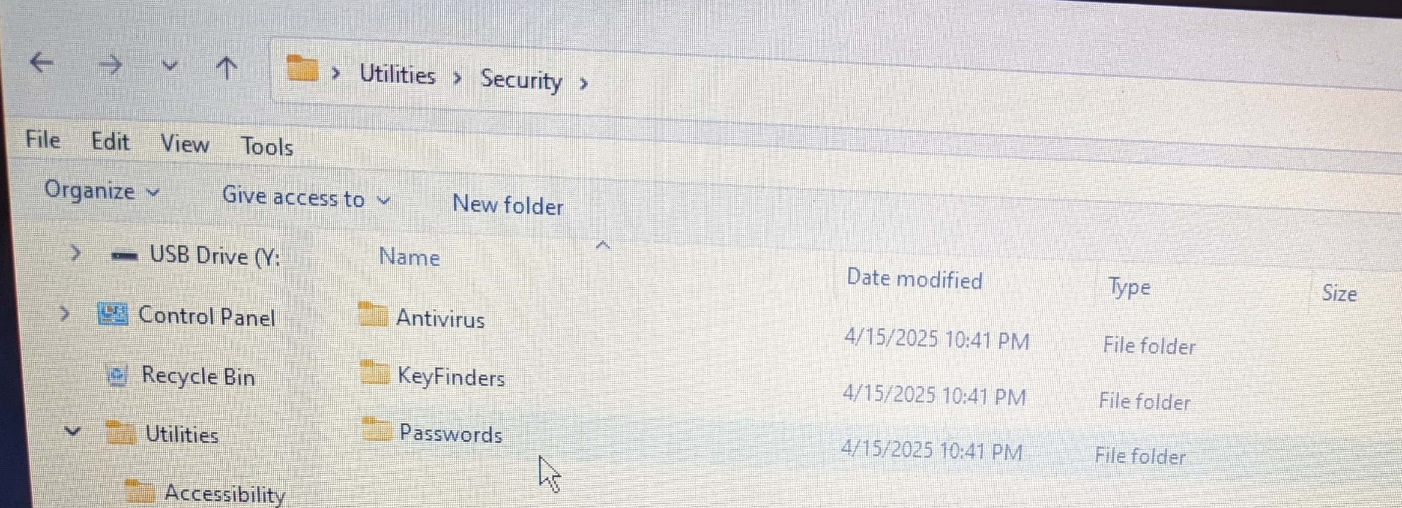
Passwords
Navigate to the folder called Passwords

Slide 30
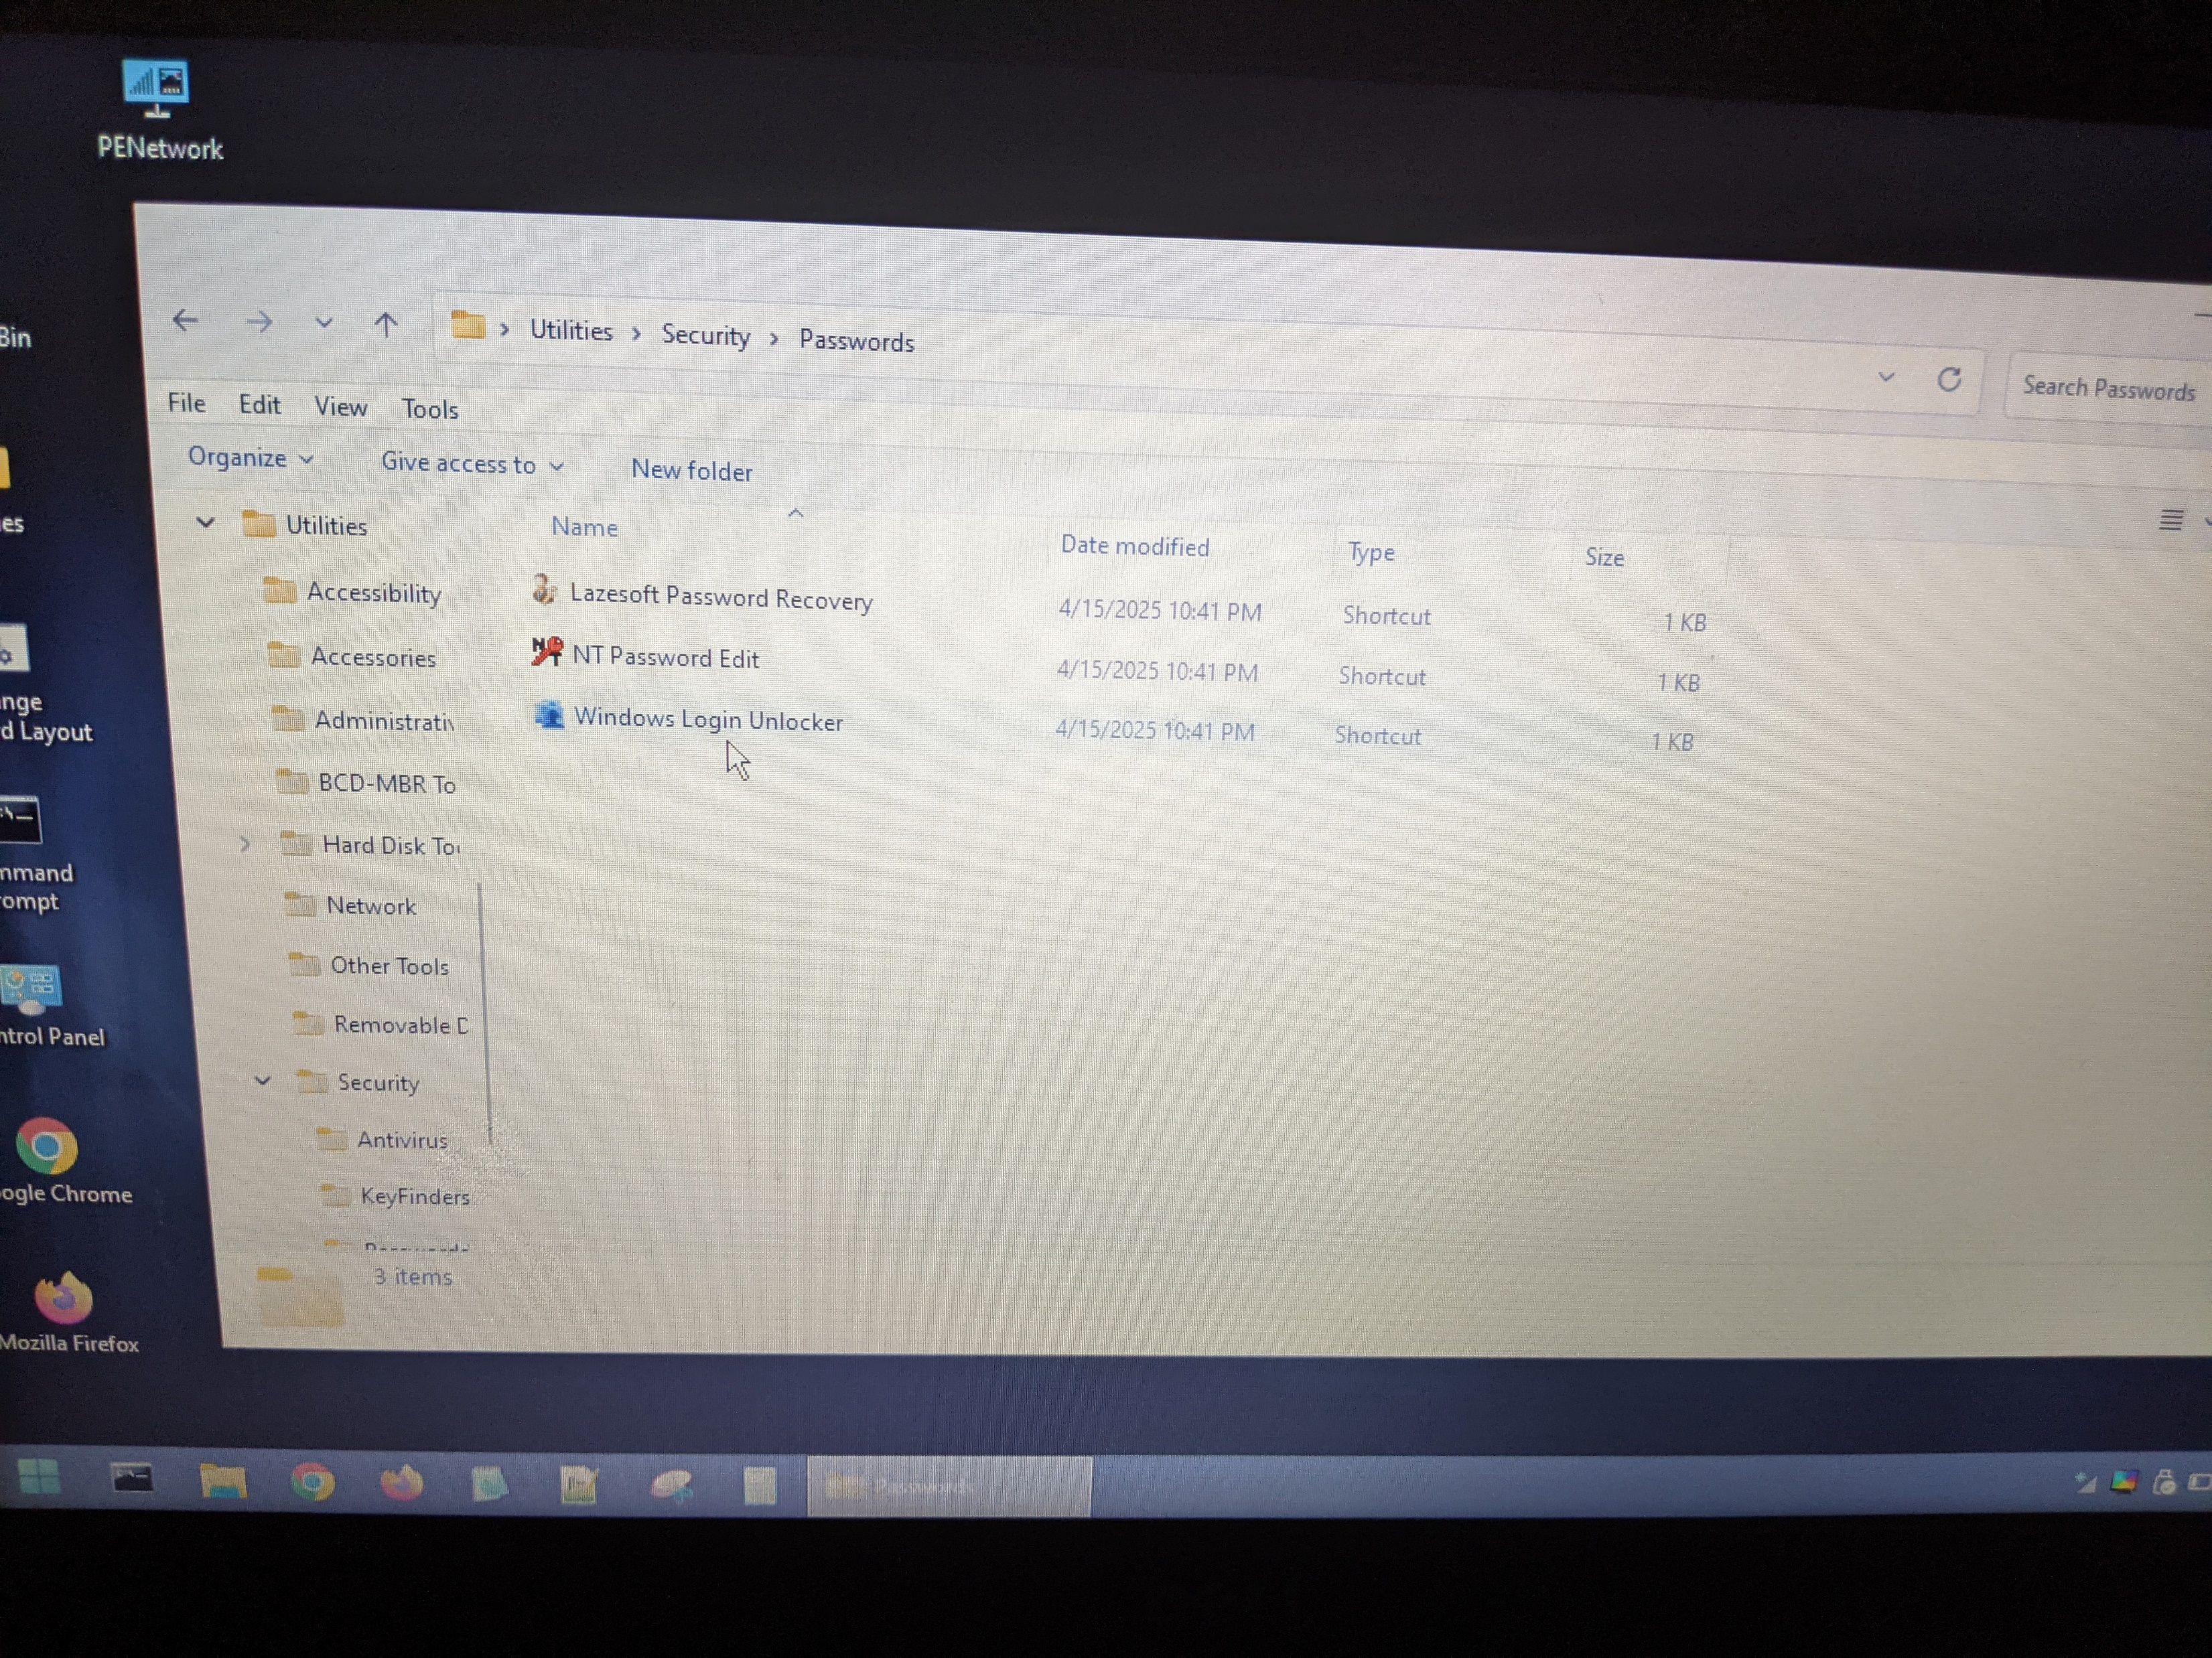
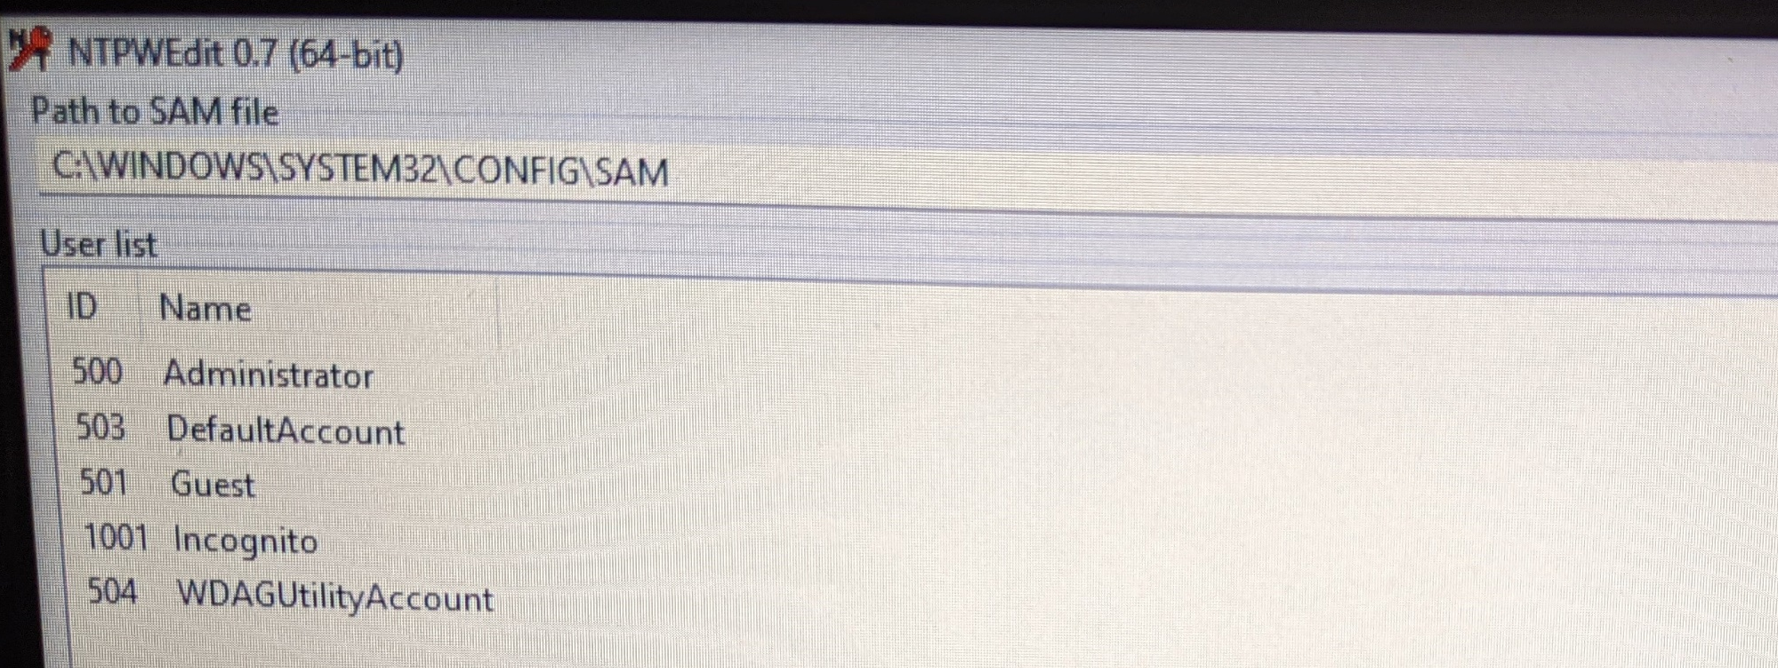
NT Password Edit
Tools → NT Password Edit

Slide 31
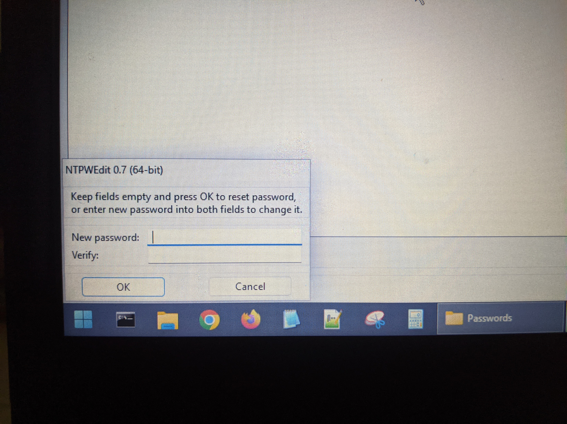
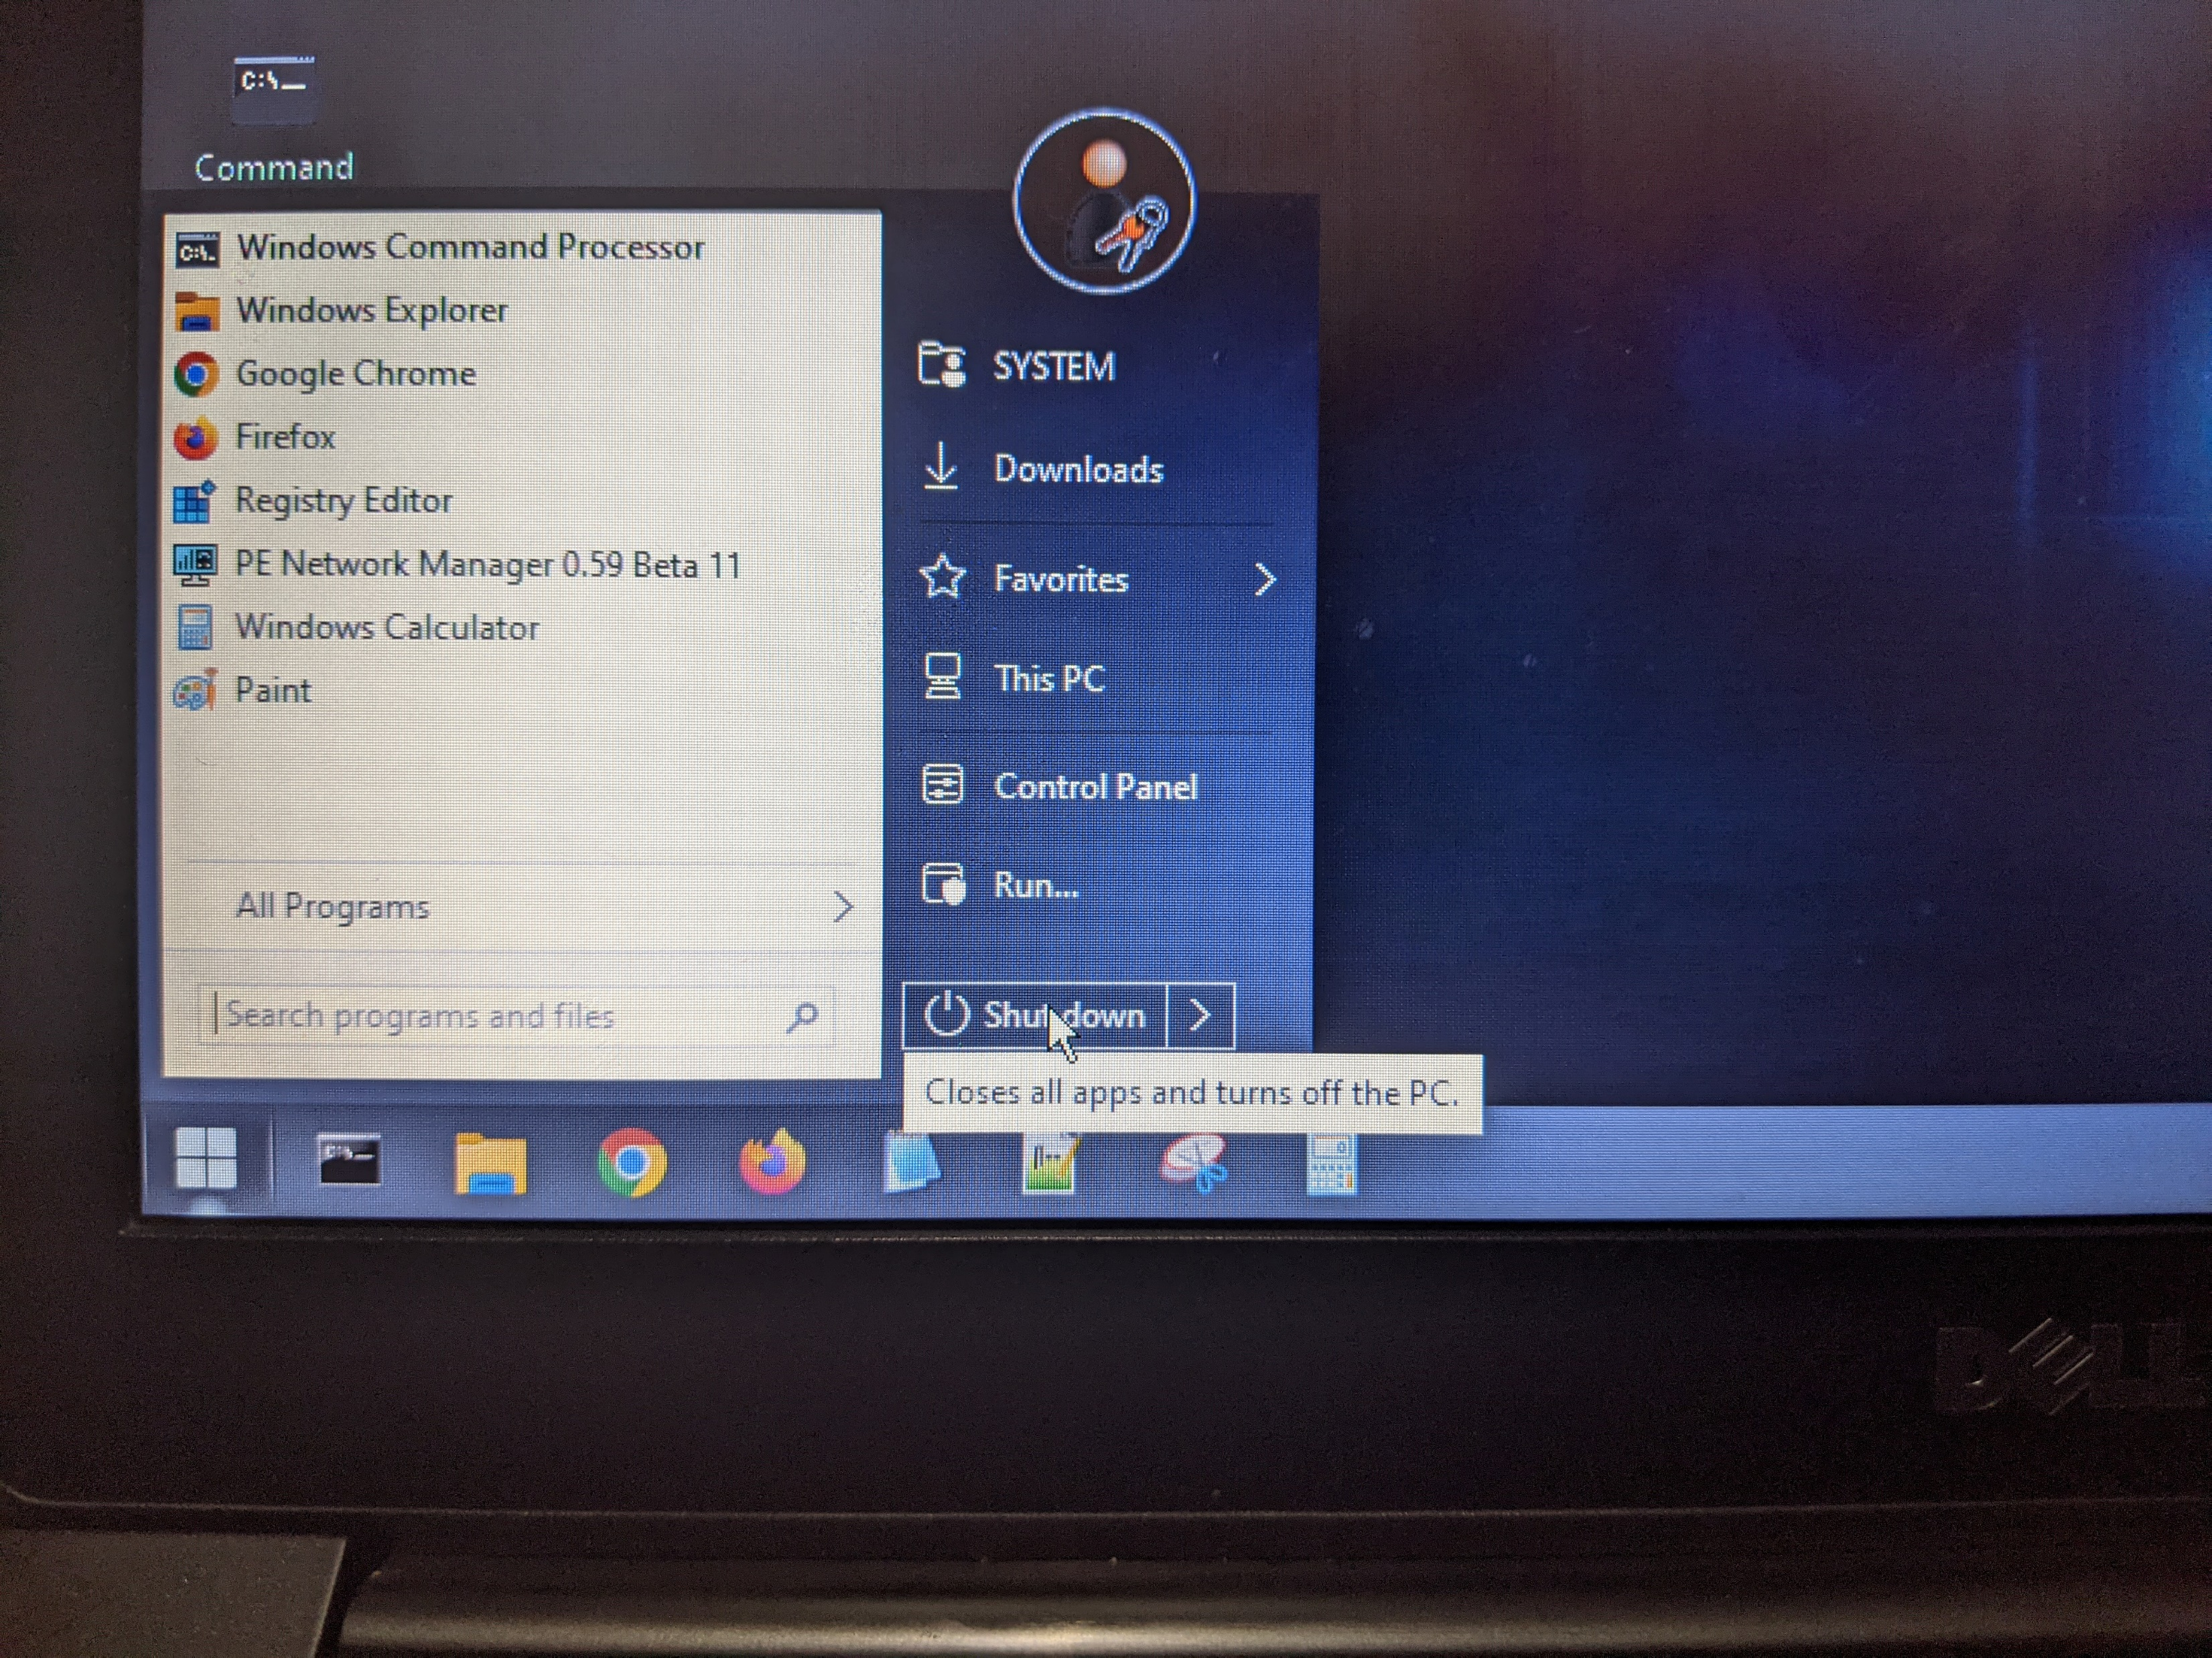
Changing The User Password
Change the password for the user and shutdown Hiren’s BootCD PE.

Slide 32
Questions?
End of Presentation

